Slide 1






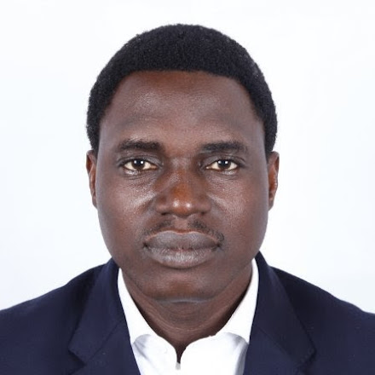










JOHNSON ADESHINA
Product Strategist & Manager, Java Application Developer , UX Designer,
Dallas, TX USA
ABOUT ME
EDUCATION
Dedicated Technology Management professional with diversified experience in software and business development.
Experienced as application developer and product manager with great understanding of business requirements, application design, development and testing.
A self-starter with a proven ability to manage multiple projects and always eager to learn new skills.
WESTERN GOVERNORS’ UNIVERSITY
MBA – IT Management
NASH COMMUNITY COLLEGE
Certificate – Advertising & Graphic Designs
OLABISI ONABANJO UNIVERSITY
BSc – Business Administration
TRAININGS, CERTIFICATIONS & SKILLS
Microsoft Certified: Azure Fundamentals
IBM Enterprise Design Thinking Practitioner
IBM Garage Method for Cloud Advocate
Certified Scrum Master (CSM)
Certified Scrum Product Owner (CSPO)
AWS Academy Graduate
Certified Microsoft Technology Associate - Networking Fundamentals
Adobe Certified Associate, ACA – Rich Media Communications
COMPETENCIES
OTHER
SKILLS
APPLICATION/WEB DEVELOPMENT
Java
SpringMVC
Angular
SQL/NoSQL
HTML/CSS
Javascript
AWS/Azure/
GCP/IBM
GIT/Bitbucket/ Sonarcube
JIRA -Kanban /Confluence
Adobe Creative Suite
Figma/Sketch
Networking
PRODUCT/PROJECT MANAGEMENT
UI/UX DESIGN TOOLS
CLOUD COMPUTING
BRAND/MARKETING MANAGEMENT
PROFESSIONAL EXPERIENCE
Capgemini, America– Citi Group 09/2021 Till Date
- Software Associate
Collaborates with development teams based in US, India, and China as the Software Engineer in an agile environment to consistently deliver high-quality products that meet the bank’s overall objectives.
Manages various software development tasks using various technology stacks.
Executes and collaborated on projects within timelines and according to objectives using various project management tools – Ms. Office, Jira, Bitbucket, etc.
Facilitate amongst several technical teams interpreting user requirements to deliver functional design specifications.
HOBBIES

